Slide 1


Web Programming 2X1
JavaScript Scope and Functions

Slide 2
Outcomes
Students should understand the following outcomes, upon successful completion of this module:
Functions
Ways to define functions
Return keyword
Parameters and arguments
Function scope
Variable scope within functions (var vs let vs const)

Slide 3
Functions
Functions are reusable blocks of code that carry out a specific task.
To execute the code in a function you call/invoke it.
To create a function, use the function keyword, list parameters in parentheses, and then supply a block that contains the function’s code:
function myFunction(parameter1, parameter2, ...)
{
//function body
}
myFunction(); //function invocation

Slide 4
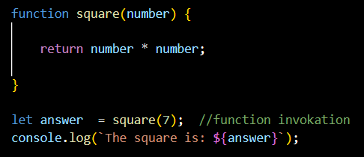
Functions
All functions return a value, which can be specified using the return statement, which comes after the return keyword.
A function that doesn’t explicitly return anything (such as all the examples we have seen so far) will return undefined by default:

Slide 5
Defining a Function
We can create functions in JavaScript using 3 ways:
Function Declaration
function add (a, b) {
return a + b;
};
var result = add(1, 2); console.log(result);
Here, we start with keyword function, then function name follows.
We may pass parameters to the function, and return the result of whatever the function needs to do; in this case, add 2 numbers

Slide 6
Defining a Function
Function Expression
var add = function (a, b) {
return a + b;
};
var result = add(1, 2); console.log(result);
Normal way we used previously.
Here, we first define a variable, called add.
We then assign to it, the result of the function (an expression), after passing parameters to the function, and return whatever the function needs to do, in this case, add 2 numbers together.

Slide 7
Defining a Function
Anonymous or Arrow Functions
Here, we first define a variable, called add.
We then assign to it, an anonymous function, after passing parameters to this function.
An anonymous function is a function without a name and keyword function.
We the return whatever the function needs to do, in this case, add 2 numbers together.
let add = (a, b) => {return a + b};
var result = add(1, 2);
console.log(result);

Slide 8
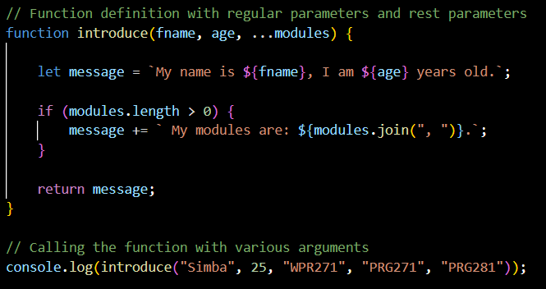
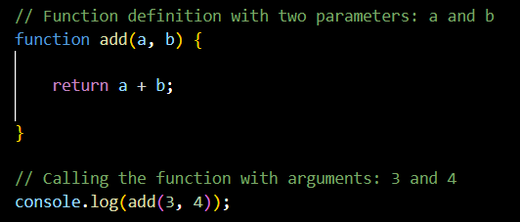
Function Parameters & Arguments
Parameters are the variables listed as a part of the function definition.
Arguments are the values passed to the function when it is invoked.
Rest parameters allow a function to accept an indefinite number of arguments as an array.
Notes:
Output:
60
John scored 25

Slide 9
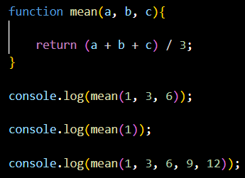
Parameters
You can use as many parameters as you like when defining functions.
If a parameter is not provided through an argument when the function is invoked, the function will still be invoked, but the parameter will be given a value of undefined.
If we try to invoke the mean function with only 1 argument, it returns NaN because the function cannot do the required operation with undefined.
If too many arguments are provided when a function is invoked, the function will work as normal and the extra arguments will be ignored.
Notes:
Output:
60
John scored 25

Slide 10
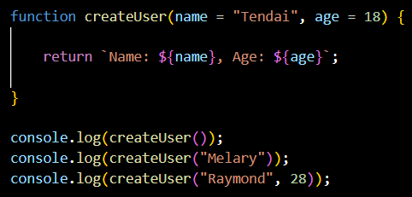
Default Parameters
In JavaScript, parameters of functions default to undefined.
However, in some situations it might be useful to set a default value.
Default parameters that will use default values for any parameter that isn’t provided as an argument.
Notes:
Output:
60
John scored 25

Slide 11
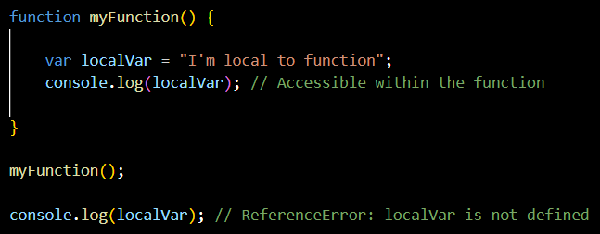
Function Scope
When you define a function, it creates a scope.
"scope" refers to the region of the program where a variable is defined and accessible.
It determines the visibility and lifespan of variables, functions, and objects within a code block.
Variables defined inside a function cannot be accessed from anywhere outside the function, because the variable is defined only in the scope of the function.
However, a function can access all variables and functions defined inside the scope in which it is defined.

Slide 12
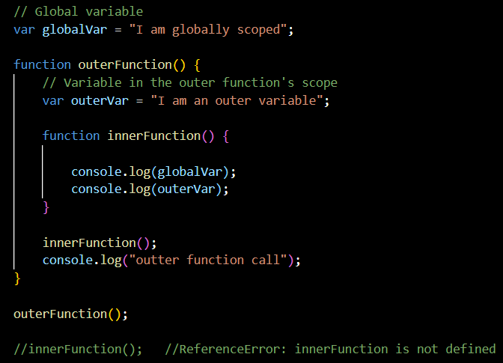
Function Scope
However, a function defined in the global scope can access all variables defined in the global scope.
A function defined inside another function can also access all variables defined in its parent function, and any other variables to which the parent function has access to.

Slide 13
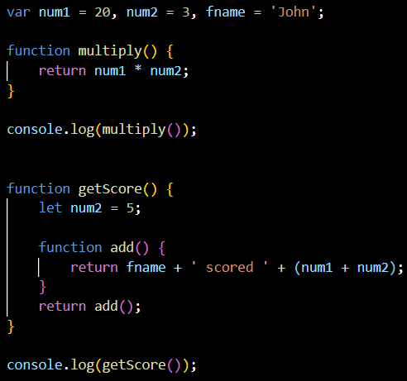
Function Scope
Analyze the code to determine the output.
Run it in console to verify.
Notes:
Output:
60
John scored 25

Slide 14
Variable Scope
JavaScript introduced new features when ES2015 (ES6) was introduced.
Before 2015, using the var keyword was the only way to declare a JavaScript variable.
The 2015 version of JavaScript (ES6) allows the use of the const keyword to define a variable that cannot be reassigned, and the let keyword to define a variable with restricted scope.
var a = 7;
let a = 7;
const a = 7;
Declarations:

Slide 15
Scope of Var
var declarations can be globally scoped or function/locally scoped.
var greet = "hey hi";
function newFunction() {
var message = "hello";
};
Global vs. Function Scope:
Here, greet is globally scoped because it exists outside a function, while message is function scoped.
So we cannot access the variable message outside the function.

Slide 16
var
var variables can be re-declared and updated
This means that we can declare a variable, assign it a value, and replace the first value with another value, if they variables are within the same scope.
We won't get an error if:
var message = "hey hi";
var message = "say Hello instead";
console.log(message);
This means that declared variables can get their values changes at any time that the program is running, and that brings with it security issues when working with var.
Sometimes, you may not want to change the value of an assigned variable at run time.

Slide 17
Hoisting of var
Hoisting is a JavaScript mechanism where variables and function declarations are moved to the top of their scope before code execution..
Example:
console.log (greeter);
var greeter = "say hello“;
The compiler will interpret this as:
var greeter;
console.log(greeter); // greeter is undefined
greeter = "say hello"
var variables are hoisted to the top of their scope and initialized with a value of undefined.

Slide 18
let
let is now preferred for variable declaration as it comes as an improvement to var declarations. It also solves the problems associated with var.
let is block scoped
A block is a chunk of code bounded by { }. A block lives in curly braces. Anything within curly braces is a block.
So a variable declared in a block with let is only available for use within that block.
Example:
let times = 4;
if (times > 3) {
let message = "say Hello instead";
console.log(message); // "say Hello instead"
}
console.log(message) // hello is not defined
Notes:
ReferenceError: hello is not defined

Slide 19
let
let can be updated but not re-declared.
Just like var, a variable declared with let can be updated within its scope.
Unlike var, a let variable cannot be re-declared within its scope.
Example:
let greeting = "say Hi";
greeting = "say Hello instead";
console.log(greeting) // works
let greeting = "say Hi";
let greeting = "say Hello instead";
console.log(greeting) // error
Notes:
SyntaxError: Identifier 'greeting' has already been declared

Slide 20
let
However, if the same variable is defined in different scopes, there will be no error:
let greeting = "say Hi";
if (true) {
let greeting = "say Hello instead";
console.log(greeting); // "say Hello instead"
}
console.log(greeting); // "say Hi"
This works because both instances are treated as different variables since they have different scopes.
This fact makes let a better choice than var. When using let, you don't have to bother if you have used a name for a variable before as a variable exists only within its scope.
Notes:
SyntaxError: Identifier 'greeting' has already been declared

Slide 21
Hoisting of let
Just like var, let declarations are hoisted to the top.
Unlike var which is initialized as undefined, the let keyword is not initialized.
If you try to use a let variable before declaration, you'll get a Reference Error:
console.log (greeter);
let greeter = "say hello";
Notes:
ReferenceError: Cannot access 'greeter' before initialization

Slide 22
const
Variables declared with the const maintain constant values.
const declarations share some similarities with let declarations.
const declarations are block scoped.
Like let declarations, const declarations can only be accessed within the block they were declared:
const times = 4;
if (times > 3) {
const message = "say Hello instead";
console.log(message); // "say Hello instead"
}
console.log(message) // hello is not defined
Notes:
ReferenceError: hello is not defined

Slide 23
const
const cannot be updated or re-declared.
This means that the value of a variable declared with const remains the same within its scope.
So if we declare a variable with const, we can neither do this:
const greeting = "say Hi";
greeting = "say Hello instead";
const greeting = "say Hi";
const greeting = "say Hello instead";
nor:
TypeError: Assignment to constant variable.
SyntaxError: Identifier 'greeting' has already been declared
Every const declaration, therefore, must be initialized at the time of declaration.

Slide 24
Hoisting of const
Just like let, const declarations are hoisted to the top but are not initialized.
var declarations are globally scoped or function scoped while let and const are block scoped.
var variables can be updated and re-declared within its scope; let variables can be updated but not re-declared; const variables can neither be updated nor re-declared.
They are all hoisted to the top of their scope. But while var variables are initialized with undefined, let and const variables are not initialized.
While var and let can be declared without being initialized, const must be initialized during declaration.
Differences:

Slide 25
Exercises
Exercises on Functions on Moodle

Slide 26
Thank You!
The End
/belgiumcampusSA
#Belgium Campus
info@belgiumcampus.ac.za
+27 10 593 53 68
/belgiumcampus

